Slide 1




Clark County Commute Survey
REPLACE IMAGE WITH UNIQUE QR CODE
Take the survey:
INSERT UNIQUE SURVEY LINK

Slide 2
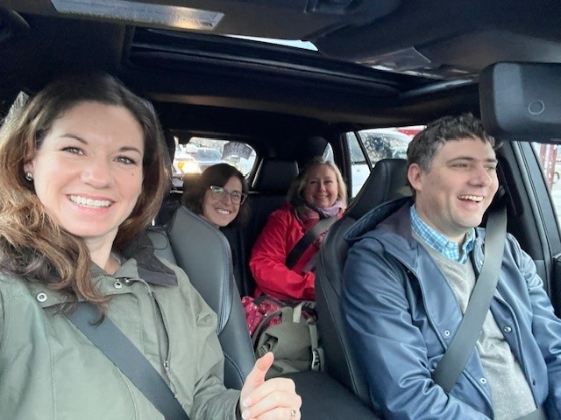
Clark County Commute Survey
Take the survey:
INSERT UNIQUE SURVEY LINK
REPLACE IMAGE WITH UNIQUE QR CODE

Slide 3
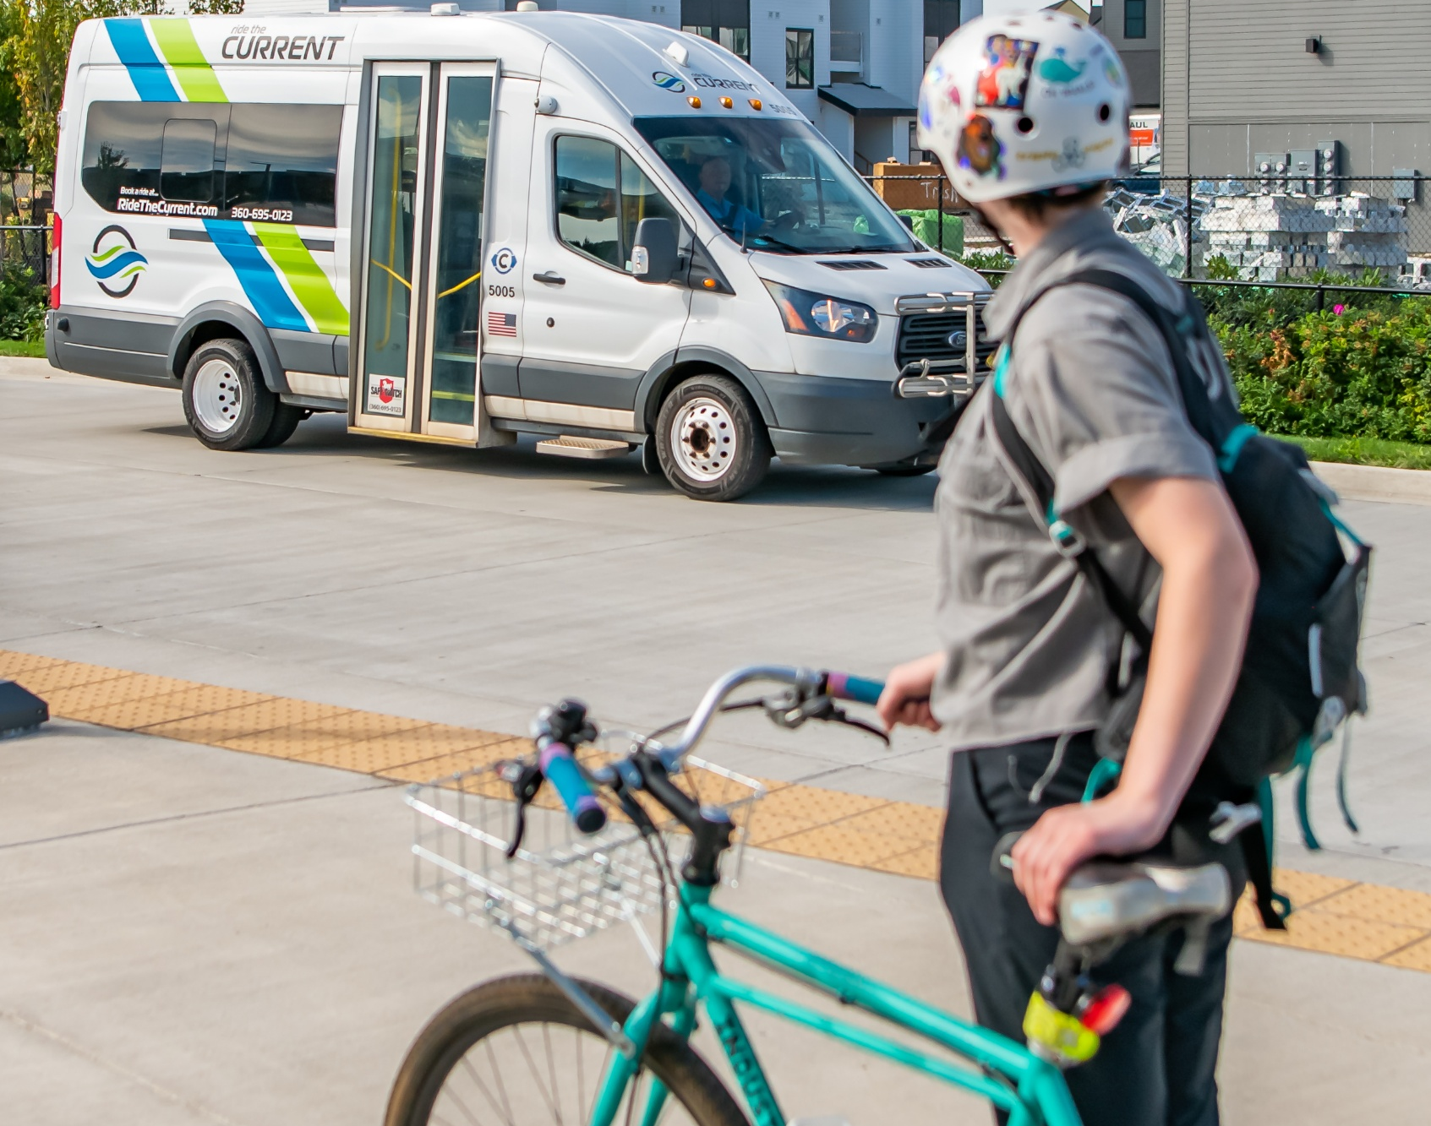
Clark County Commute Survey
Take the survey:
INSERT UNIQUE SURVEY LINK
REPLACE IMAGE WITH UNIQUE QR CODE

Slide 4
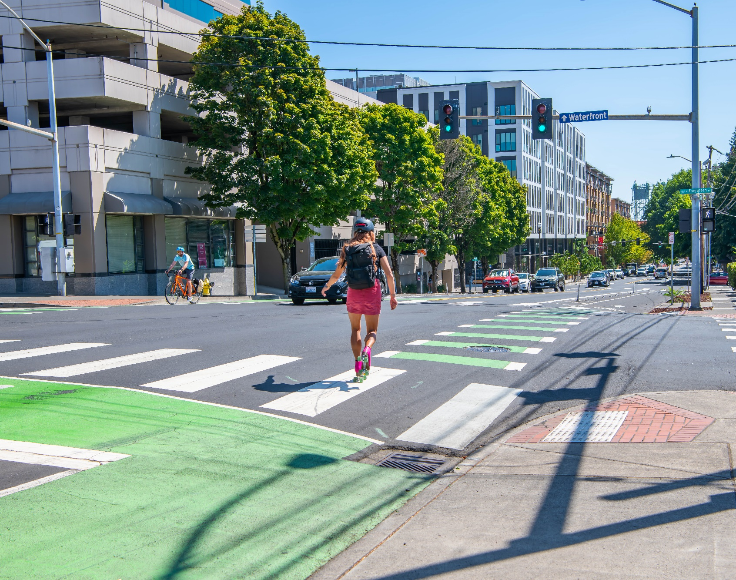
Clark County Commute Survey
Take the survey:
INSERT UNIQUE SURVEY LINK
REPLACE IMAGE WITH UNIQUE QR CODE

Slide 5
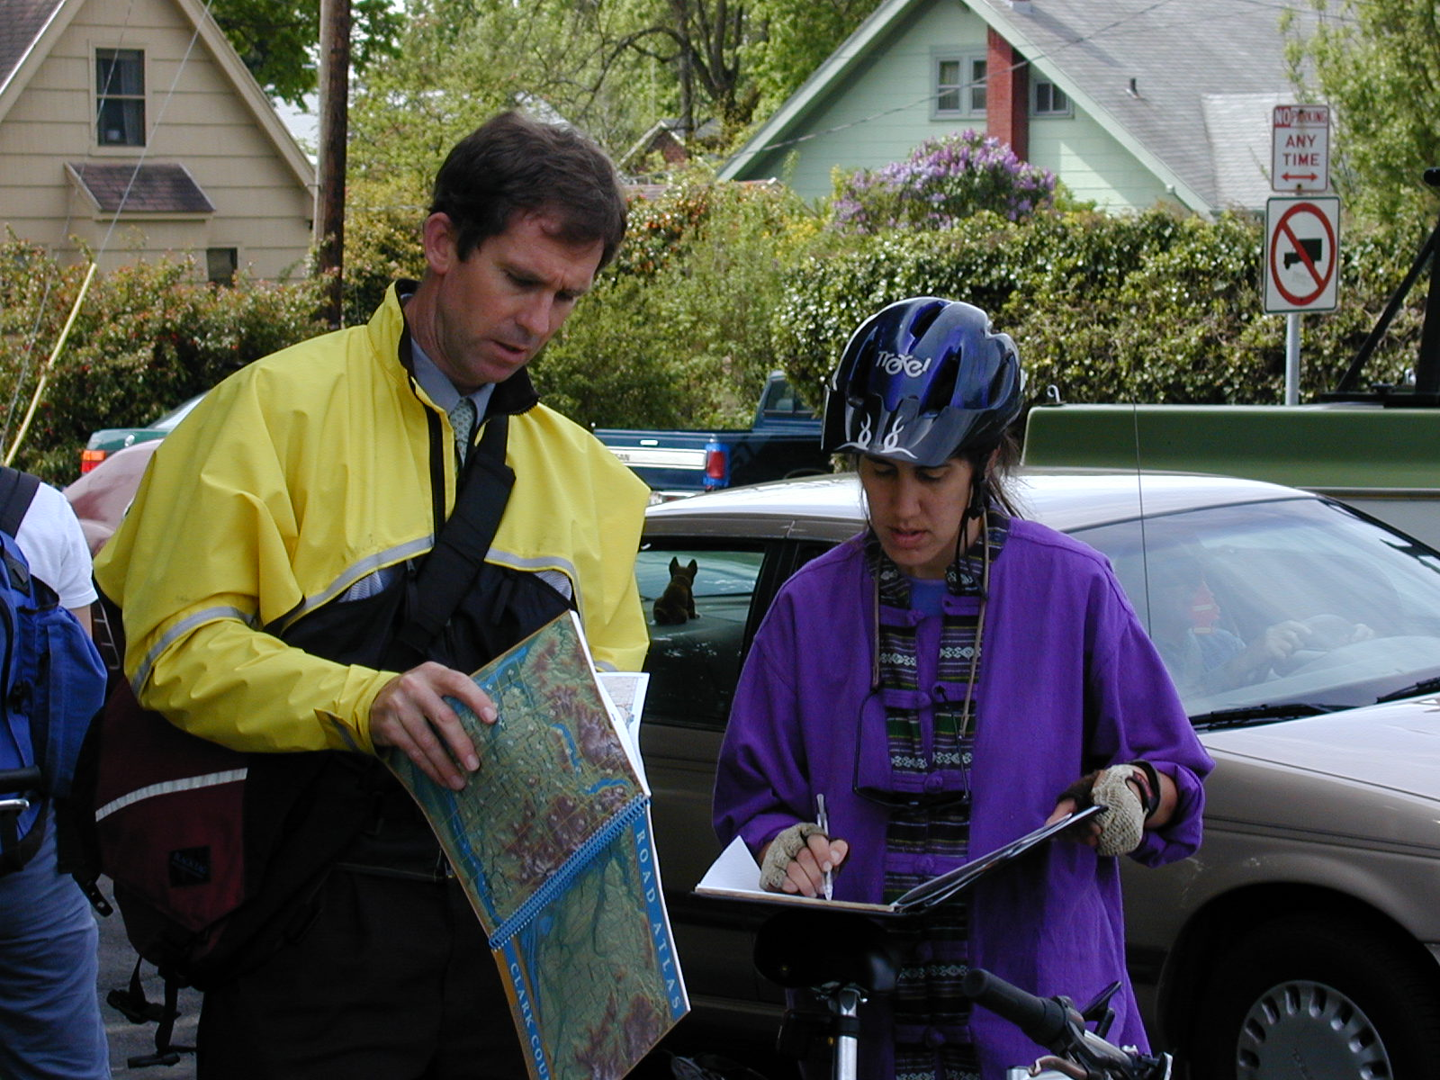
Clark County Commute Survey
Take the survey:
INSERT UNIQUE SURVEY LINK
REPLACE IMAGE WITH UNIQUE QR CODE

Slide 6
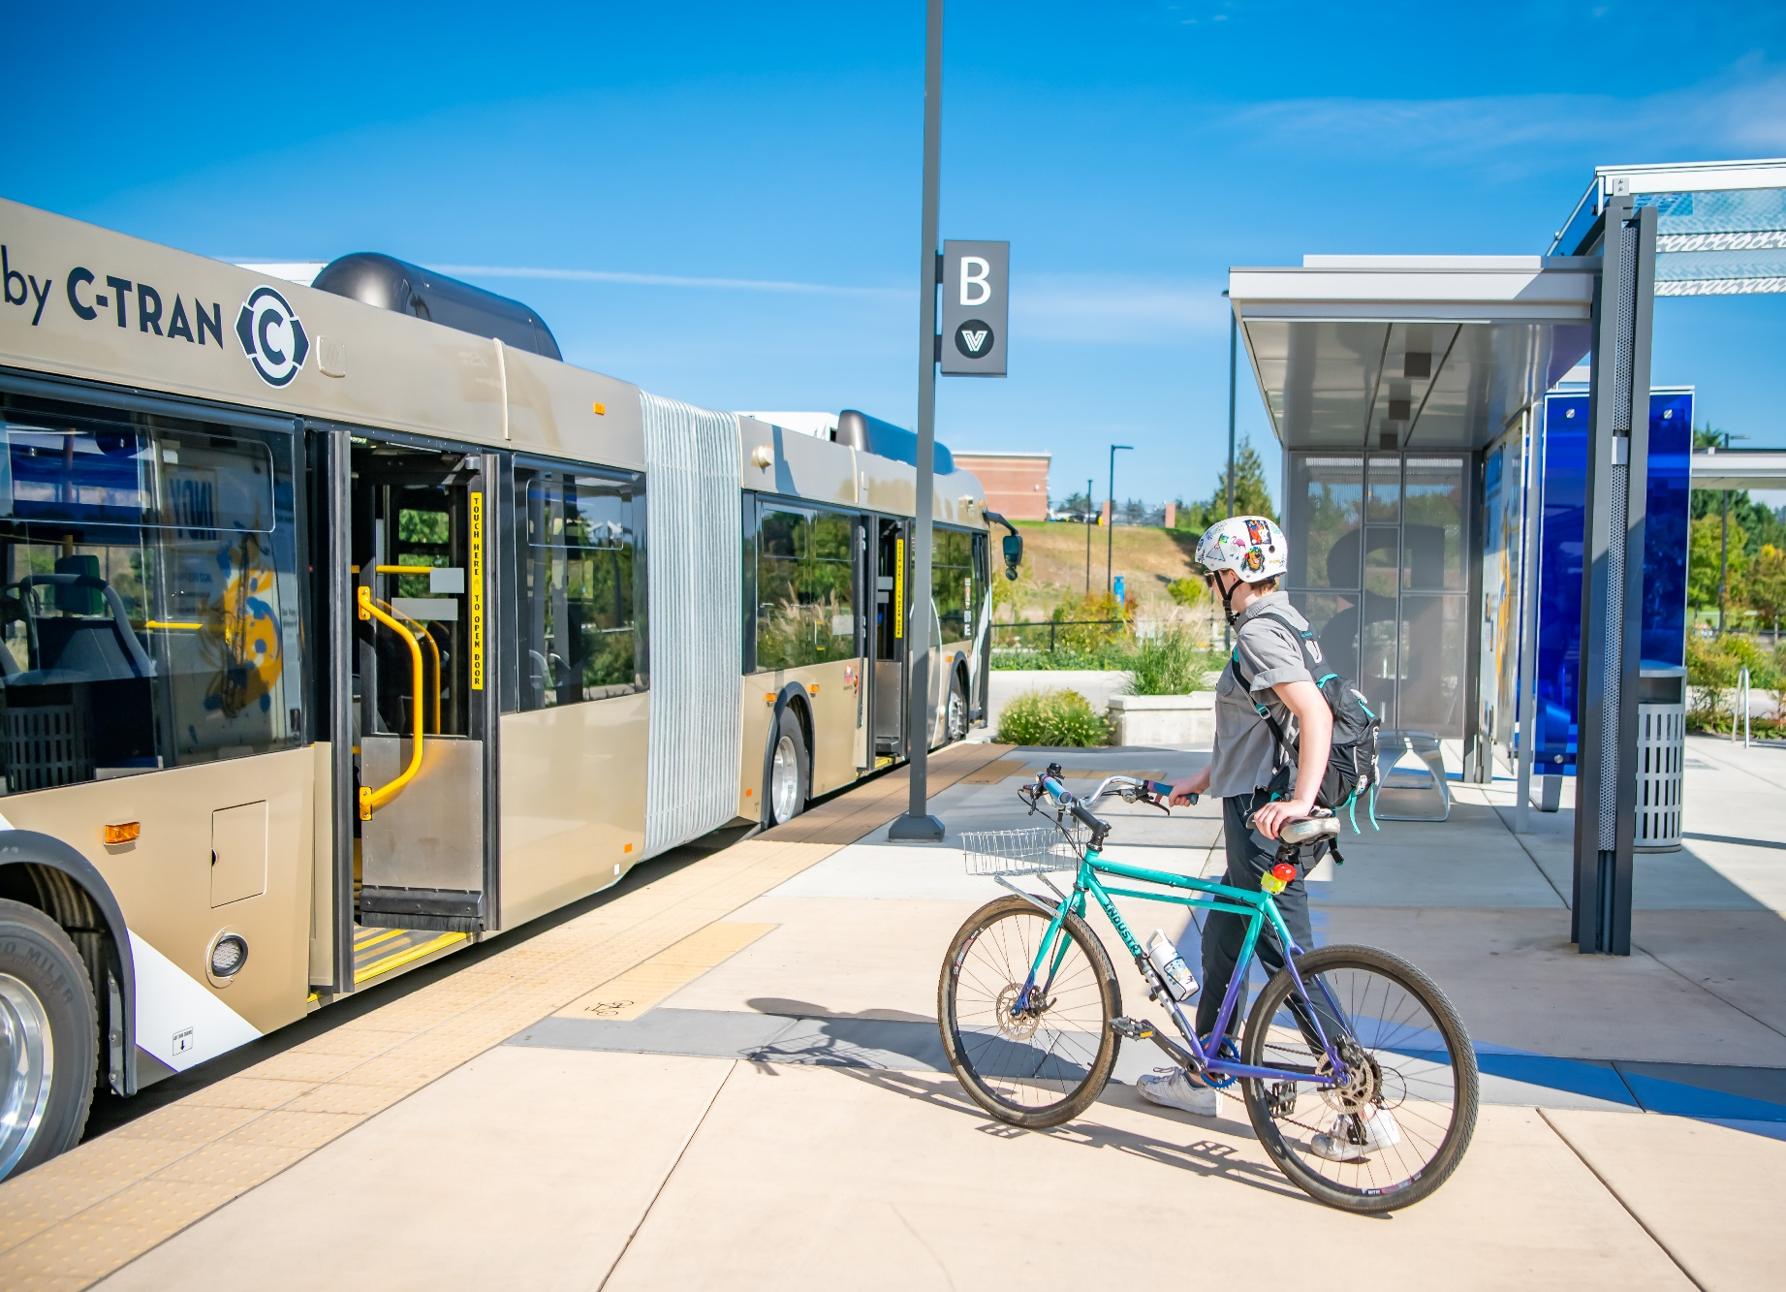
Clark County Commute Survey
Take the survey:
INSERT UNIQUE SURVEY LINK
REPLACE IMAGE WITH UNIQUE QR CODE

