Slide 1
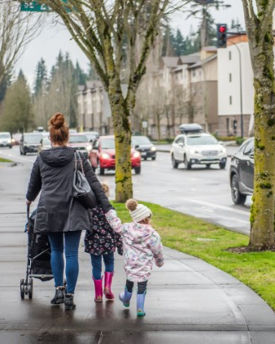
Commute Trip Reduction ETC Survey Training
Olivia Kahn, TDM-CP (She/Her/Hers)
Travel Options Coordinator
Community Development
April 3, 2024

Slide 2
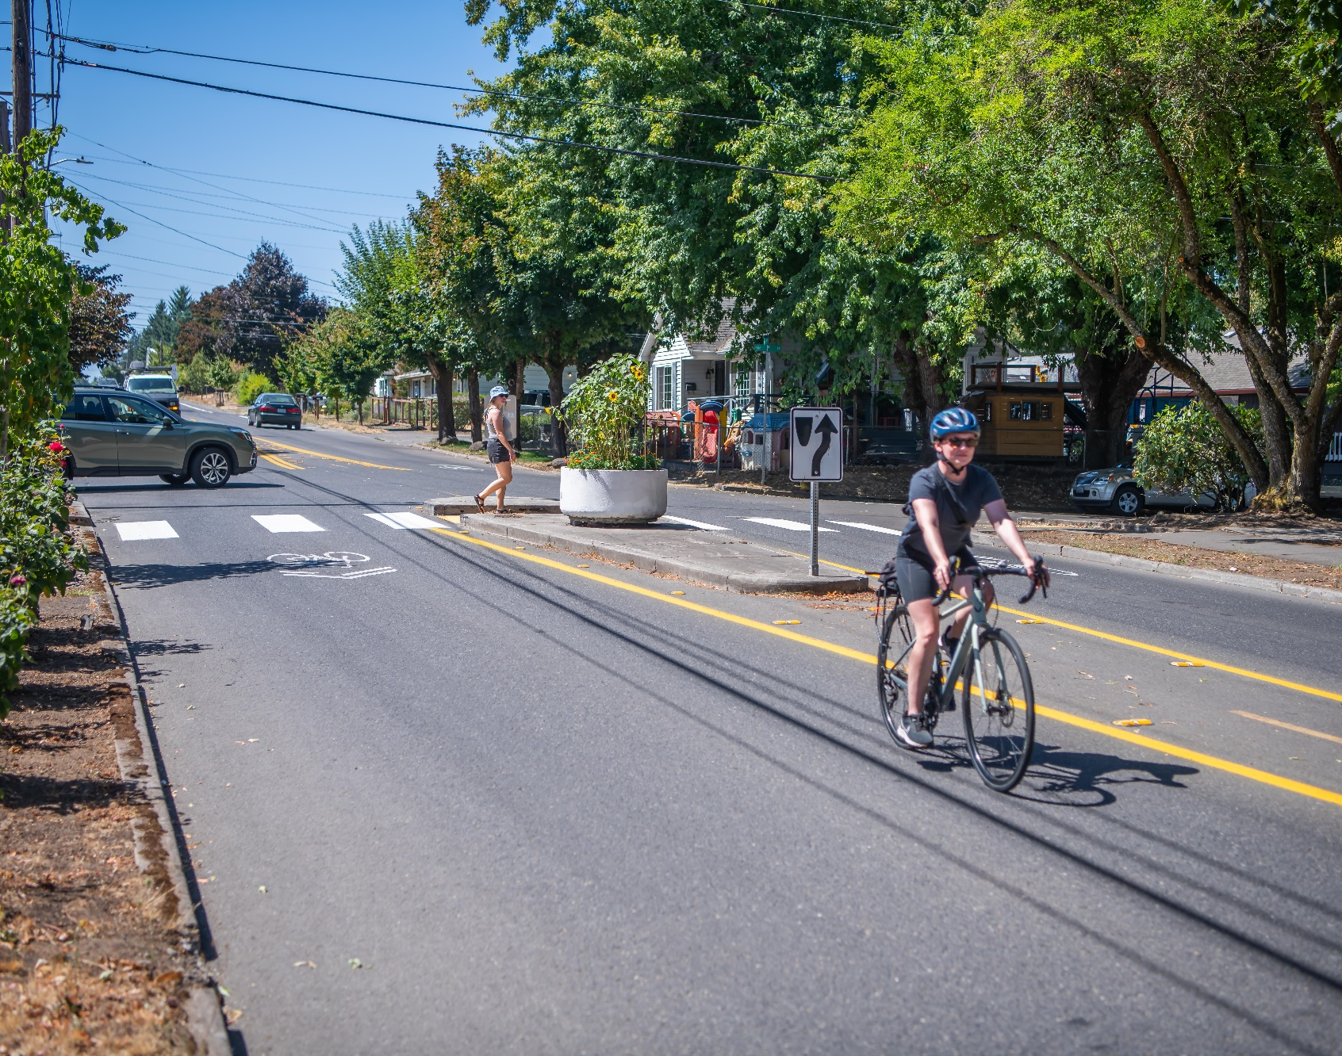
Housekeeping
Please introduce yourself in the chat
Update your display name to include your organization
This training will be recorded
2 | Commute Trip Reduction Employee Transportation Coordinator Survey Training

Slide 3

Agenda
Purpose of the survey
Step-by-Step guide
Incentives and marketing
Survey results and close out
Pre-Survey Homework for ETCs
3 | Commute Trip Reduction Employee Transportation Coordinator Survey Training

Slide 4
What is CTR? Why do we have to survey?
“Commute Trip Reduction”
State law and program that focuses on reducing congestion and improving air quality among the largest employers and most congested areas in Washington
Requires employers* to work with employees to reduce number and length of drive alone commute trips
Goal of the statewide program is a 60% drive alone rate by 2029
The CTR Survey is how we measure our drive alone rate over time
*With 100 or more full-time employees who begin work between 6 -9 a.m. two or more days a week
4 | Commute Trip Reduction Employee Transportation Coordinator Survey Training
Notes:
Why are we surveying now when we surveyed in 2023?
The CTR law requires WSDOT to report on CTR program performance every two years. Each jurisdiction can determine when to survey in the biennium. The Clark County Commute Trip Reduction Program changed its program to survey in the EVEN YEARS in 2024 for several reasons:
We missed a survey due to the pandemic.
To give worksites more time to complete the survey requirement by the end of the program biennium (June 30 of odd years).
CTR Law requires each jurisdiction (City of Vancouver, for example) to have a CTR Plan. CTR Plans are due every 4 years in the odd years (2025, 2029, etc.).
In short, surveying in the even years gives us all more time to meet the program requirements.

Slide 5
What is the CTR Survey Tool?
It is how we survey, developed by WSDOT, and brand new this year!
Survey is available online, in multiple languages, is anonymous and takes less than 5 minutes to complete.
Employees report their commute behavior from a typical week.
Review the CTR Survey questions online.
ETCs distribute the unique survey link to employees at a worksite.
Developed by RideAmigos, the same vendor as GetThereSWWashington.org
5 | Commute Trip Reduction Employee Transportation Coordinator Survey Training

Slide 6
How does it work exactly?
ETC submits the CTR Survey Registration Form(s) by 3/31
City staff provide you with a unique survey link and QR code for each worksite AND email templates and survey incentives
Step 1
Step 2
Step 3
Step 4
City staff set up your worksite(s) survey in the CTR Survey Tool
ETC tells people about the survey. Use the templates and digital advertising materials!
6 | Commute Trip Reduction Employee Transportation Coordinator Survey Training

Slide 7
How do I distribute the survey?
Send the unique survey link to employees
Email employees the survey link
Employees can use their smart phone to scan the QR code
Encourage employees to use a shared computer station if they do not typically work at a computer
Tell supervisors to pass around a tablet or laptop at staff meetings
If needed, email City staff to discuss a paper form option
7 | Commute Trip Reduction Employee Transportation Coordinator Survey Training

Slide 8
Who should I survey?
Worksites are required to survey all employees
You are required to survey all employees.
This includes employees that telework and/or work a hybrid work schedule.
The survey will identify your 6-9am employees (CTR-affected).
8 | Commute Trip Reduction Employee Transportation Coordinator Survey Training

Slide 9
What response rate do I need to achieve?
Response rate guidance depends on the size of the worksite
Employee Count | Target Response Rate
Under 200 | 70%
201-500 | 60%
501-1000 | 50%
1001-5000 | 30%
Over 5000 | 10%
Worksites with a larger number of employees can have a lower response rate to be significant.
Worksites with a smaller number of employees need a higher response rate to be significant.
The table is guidance and not a requirement.
9 | Commute Trip Reduction Employee Transportation Coordinator Survey Training

Slide 10
Who completed the survey?
The survey is anonymous
The survey tool does not collect email addresses.
You will not be able to run reports on who has completed the survey.
This makes it challenging to send targeted emails to employees that have not completed they survey.
WSDOT weighed the pros and cons and found people are more likely to survey if it does not collect your email address.
10 | Commute Trip Reduction Employee Transportation Coordinator Survey Training

Slide 11
How do I advertise the survey?
Download Templates
Incentives
Marketing
Clark County CTR Program is offering 100 $10 gift cards
You can host a prize drawing for company gear, items from the company café/vending machines, or breakfast/lunch with the boss
Host a pizza party or coffee hour for employees where they can also take the survey
Email from CEO with survey link
Ask manager to encourage survey participation at staff meetings
Use posters and TV slides, place on reader boards
Pop-up screen message when someone completes their timesheet, or other online messages to employees.
Download Digital Advertising Materials
11 | Commute Trip Reduction Employee Transportation Coordinator Survey Training

Slide 12
What is the Clark County CTR Survey Raffle?
Clark County CTR Program sponsoring 100 $10 gift cards
After an employee completes the CTR Survey, they will be prompted to complete a different survey for the raffle
Raffle survey asks for their name and email address
After the survey, we will draw names for the winners
Gift cards will be administered through Tango
Employees will receive an email to claim their gift card
12 | Commute Trip Reduction Employee Transportation Coordinator Survey Training

Slide 13
What happens after the survey closes?
City staff will close out your survey and send you results
City staff will close out your survey and send to WSDOT
CTR Survey Tool offers a live dashboard with survey results
You can download the survey results to Excel
ETCs can have management access to the CTR Survey Tool
13 | Commute Trip Reduction Employee Transportation Coordinator Survey Training

Slide 14
What happens after the survey closes?
City staff will close out your survey and review results with you
City staff will close out your survey and send to WSDOT
CTR Survey Tool offers a live dashboard with survey results
You can download the survey results to Excel
ETCs can have management access to the CTR Survey Tool
City staff will email the ETC to schedule a time to review the survey results
14 | Commute Trip Reduction Employee Transportation Coordinator Survey Training

Slide 15
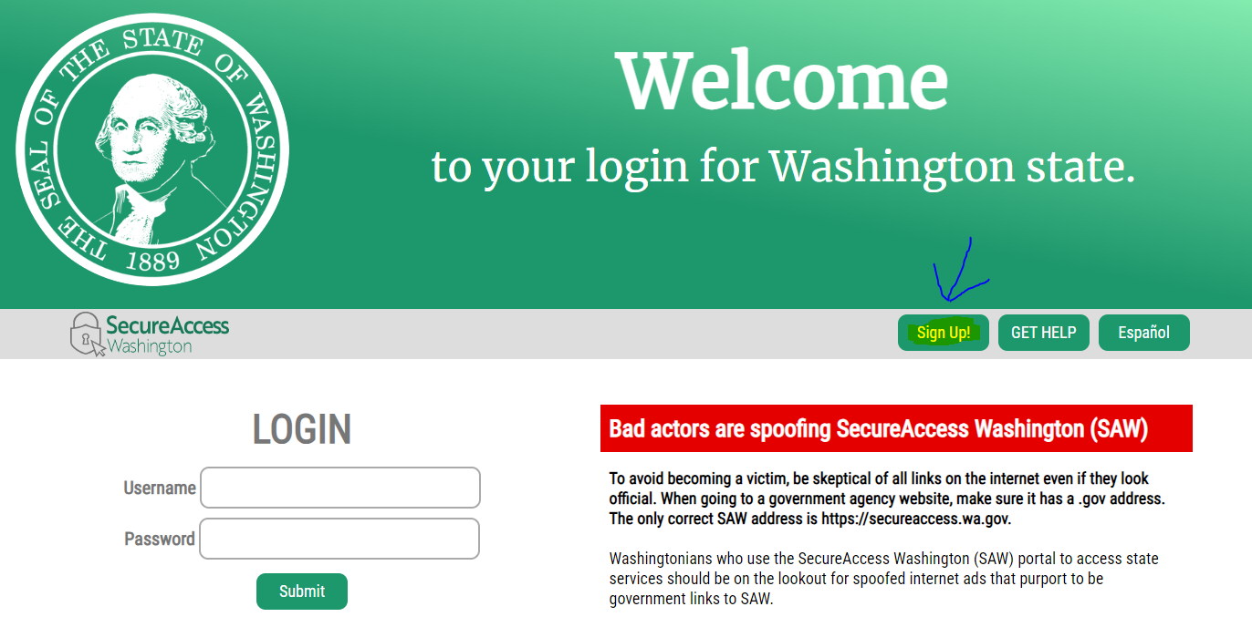
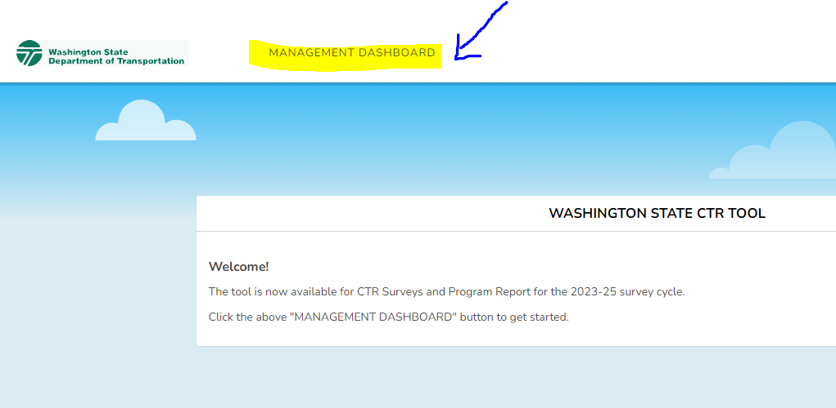
How do I get management access?
You need to set-up a Secure Access Washington (SAW) account AND
a CTR Survey Tool account
Were you an ETC before April 2023?
Set up a SAW account with your work email
Login to the CTR Survey Tool
Were you an ETC after April 2023?
Set up a SAW account with your work email
Create a CTR Survey Tool account
Notify City Staff your account is created to grant you management access
Login to the CTR Survey Tool
If you need help, email City staff!
15 | Commute Trip Reduction Employee Transportation Coordinator Survey Training

Slide 16
ETC Pre-Survey Homework
ETC submits the CTR Survey Registration Form(s) by 3/31
City staff provide you with a unique survey link and QR code for each worksite AND email templates and survey incentives
Step 1
Step 2
Step 3
Step 4
City staff set up your worksite(s) survey in the CTR Survey Tool
ETC tells people about the survey. Use the templates and digital advertising materials!
16 | Commute Trip Reduction Employee Transportation Coordinator Survey Training

Slide 17

Thank You
olivia.kahn@cityofvancouver.us | 360-487-7939 | cityofvancouver.us
17 | Commute Trip Reduction Employee Transportation Coordinator Survey Training

Slide 18




Clark County Commute Survey
REPLACE IMAGE WITH UNIQUE QR CODE
Take the survey:
INSERT UNIQUE SURVEY LINK

Slide 19
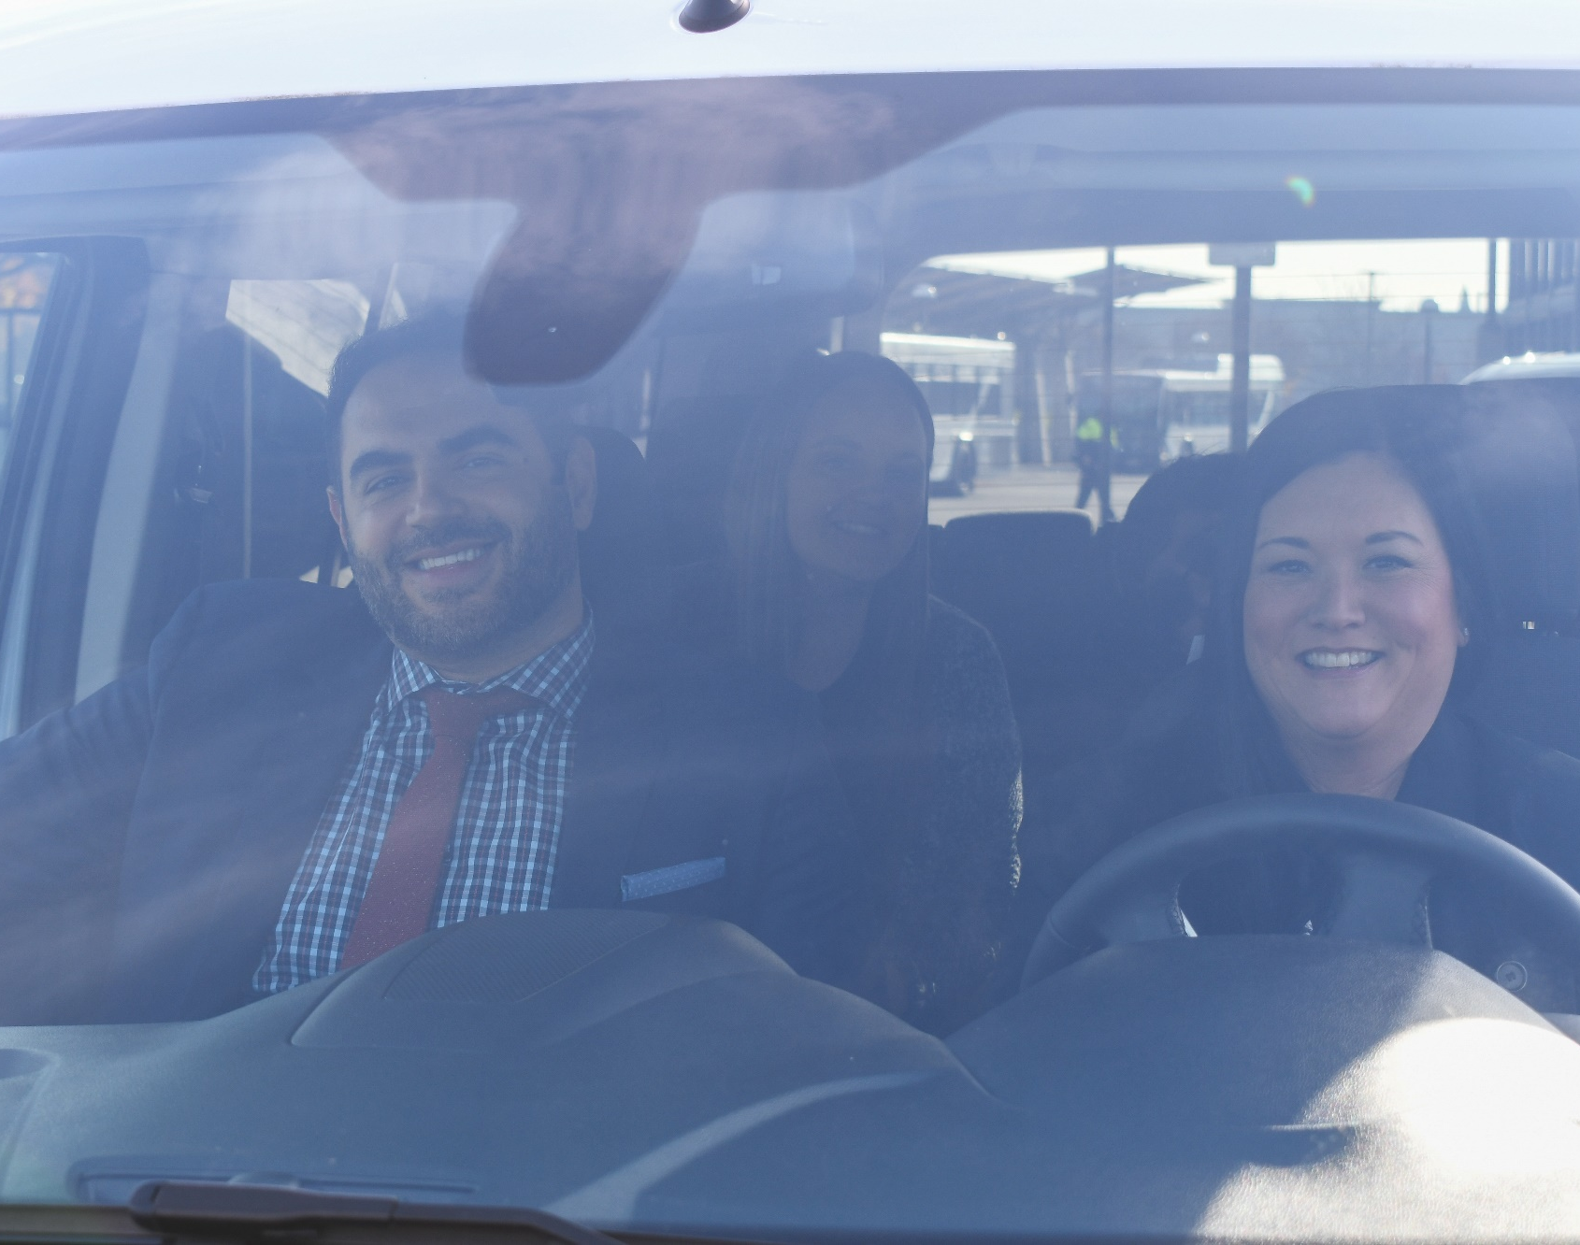
Clark County Commute Survey
Take the survey:
INSERT UNIQUE SURVEY LINK
REPLACE IMAGE WITH UNIQUE QR CODE

Slide 20
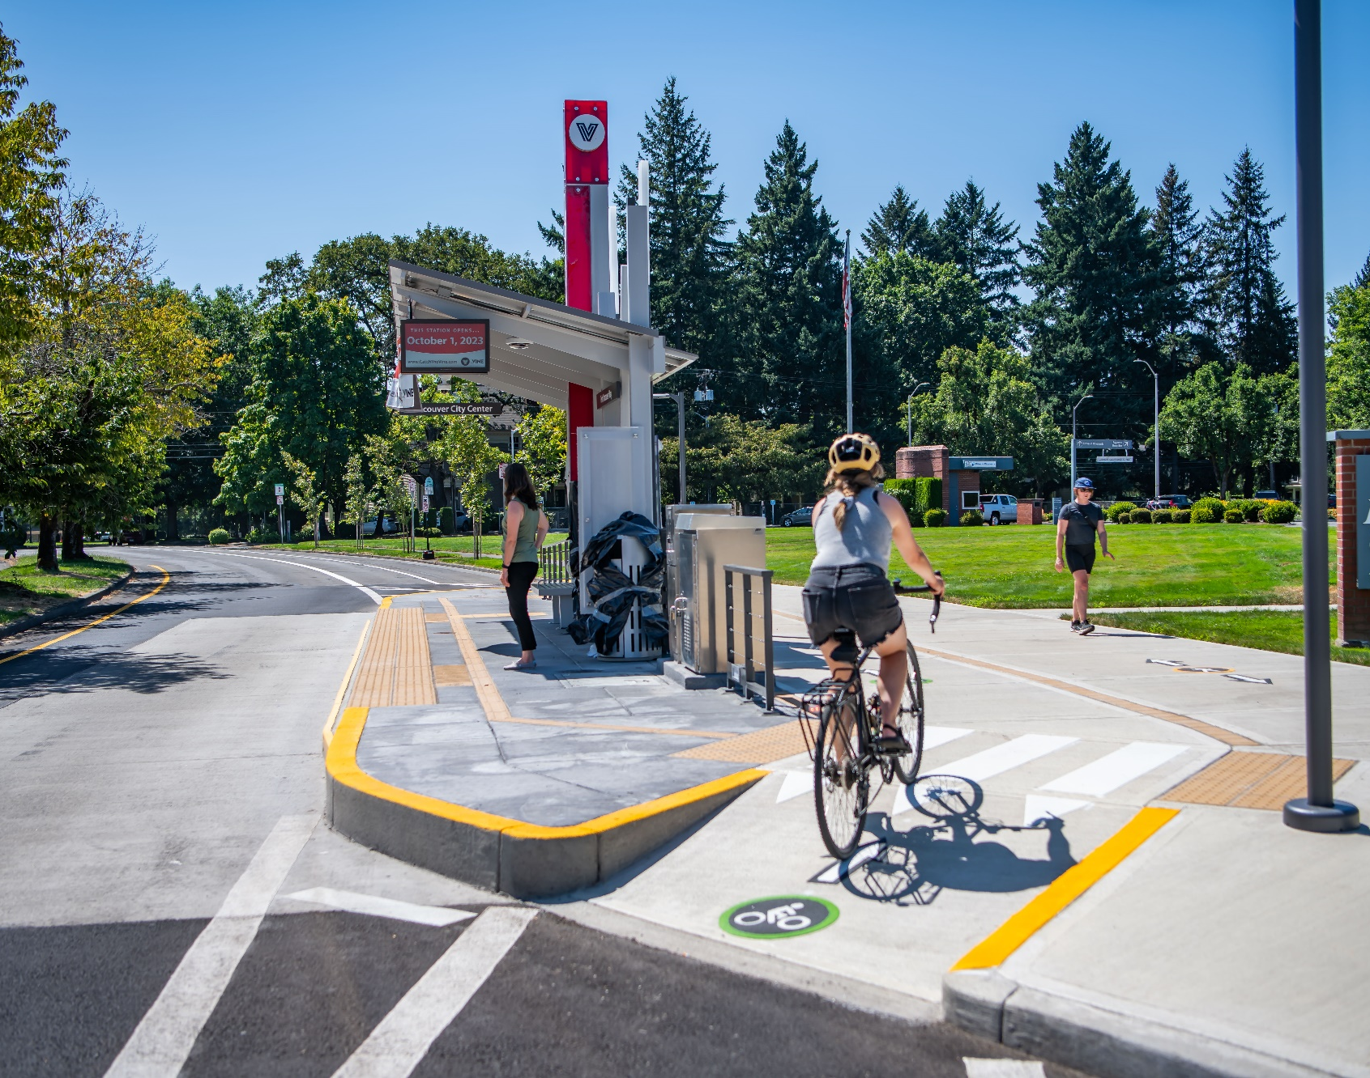
Clark County Commute Survey
Take the survey:
INSERT UNIQUE SURVEY LINK
REPLACE IMAGE WITH UNIQUE QR CODE

Slide 21
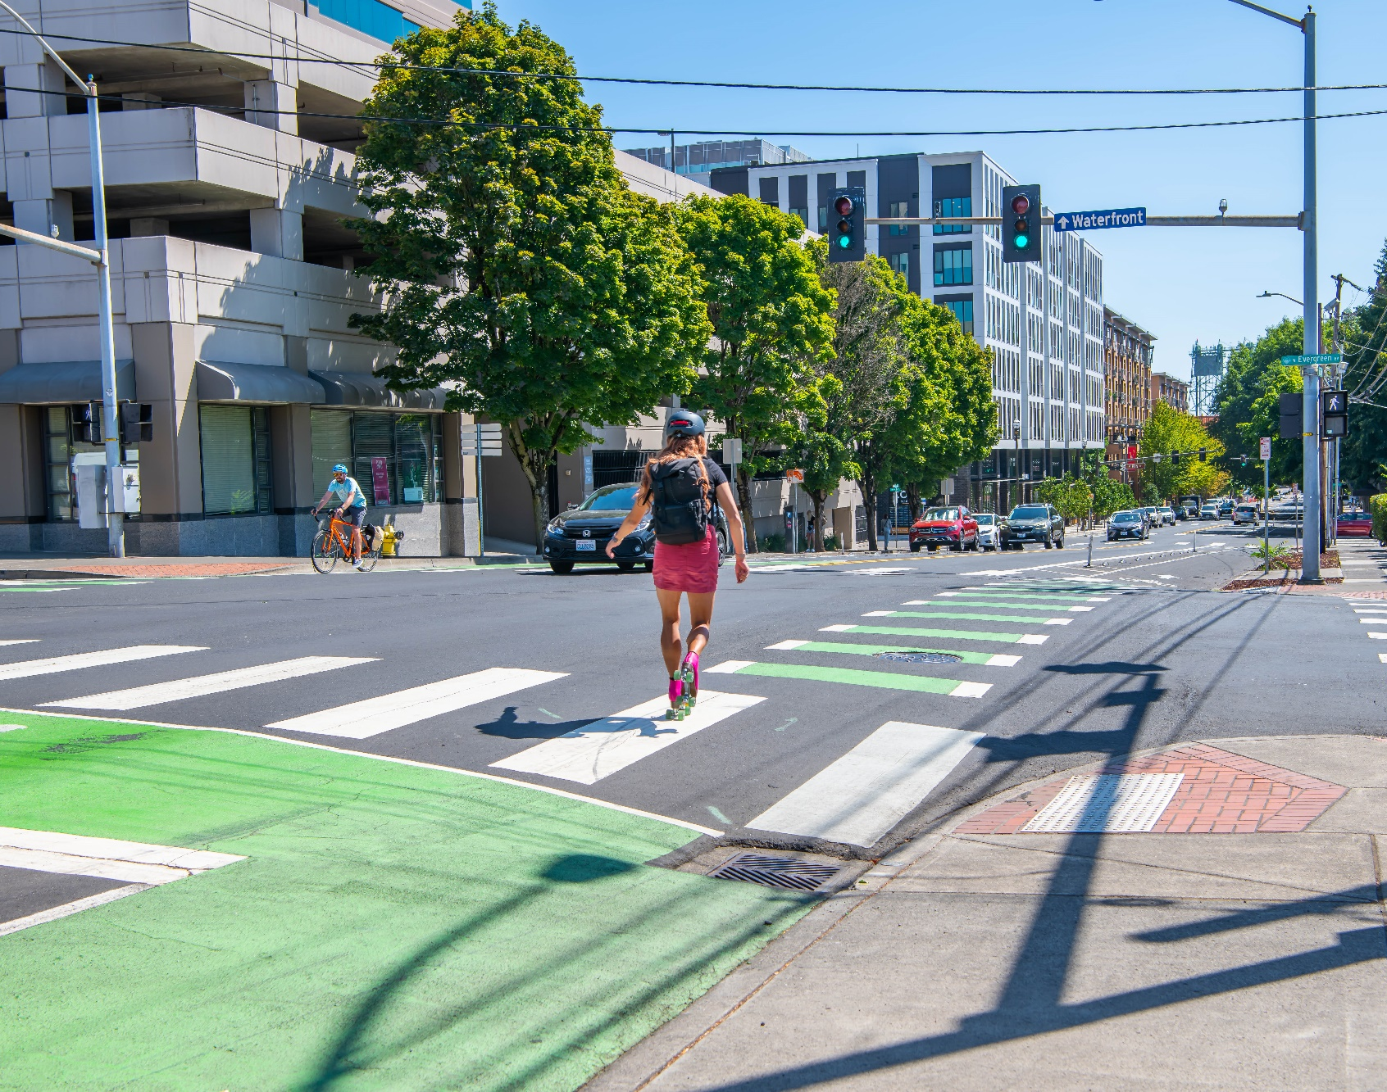
Clark County Commute Survey
Take the survey:
INSERT UNIQUE SURVEY LINK
REPLACE IMAGE WITH UNIQUE QR CODE

Slide 22
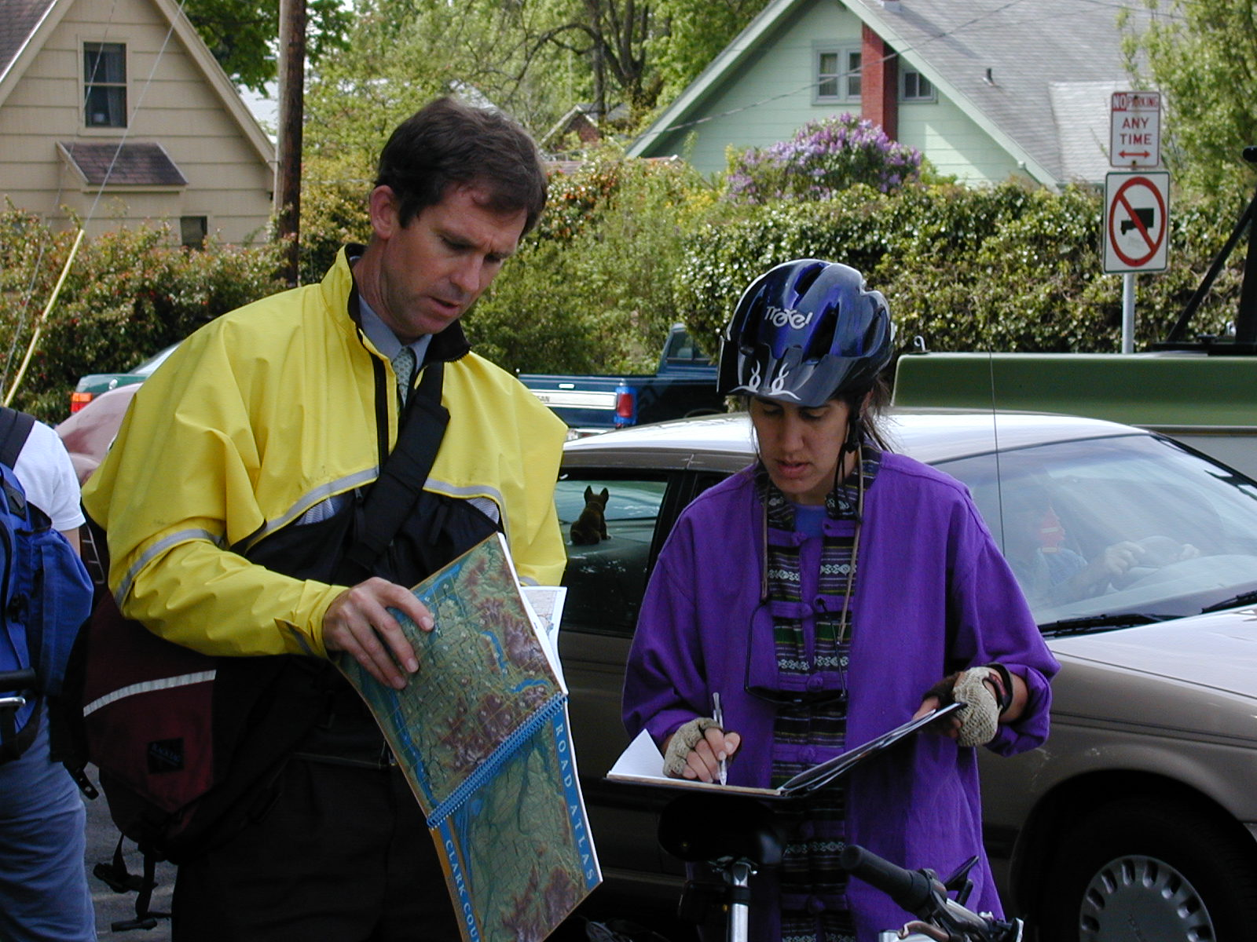
Clark County Commute Survey
Take the survey:
INSERT UNIQUE SURVEY LINK
REPLACE IMAGE WITH UNIQUE QR CODE

Slide 23
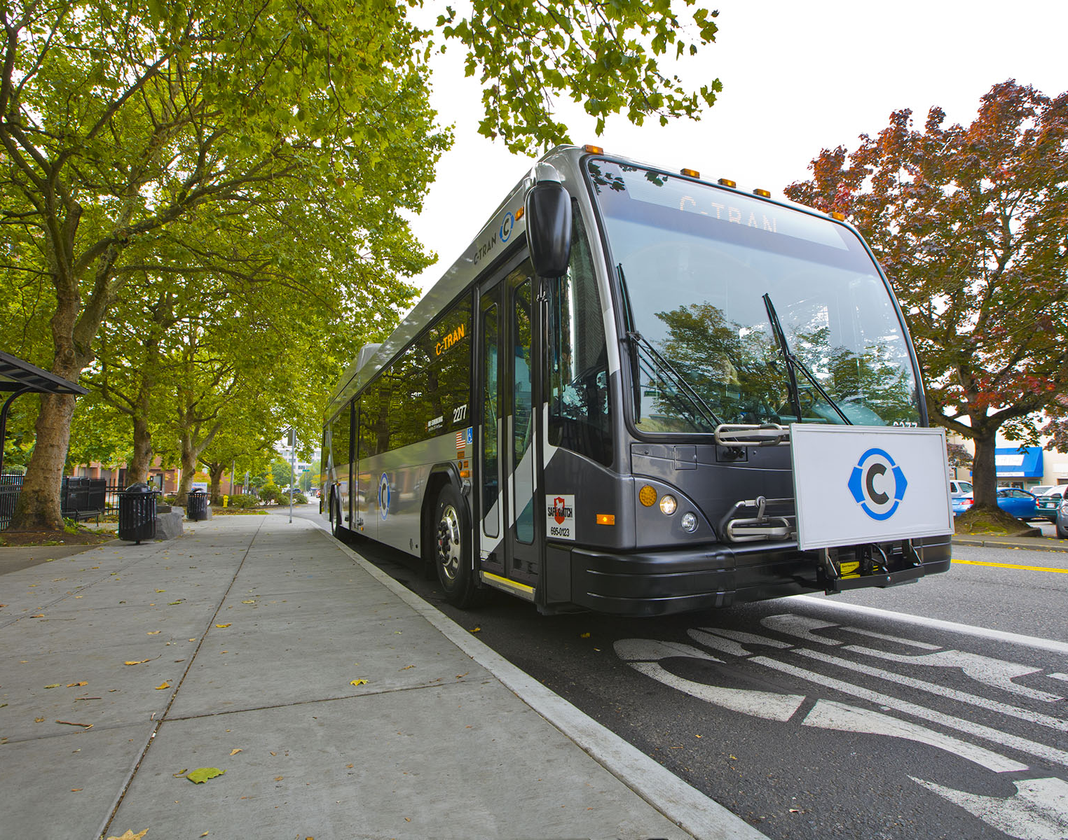
Clark County Commute Survey
Take the survey:
INSERT UNIQUE SURVEY LINK
REPLACE IMAGE WITH UNIQUE QR CODE

