Slide 1
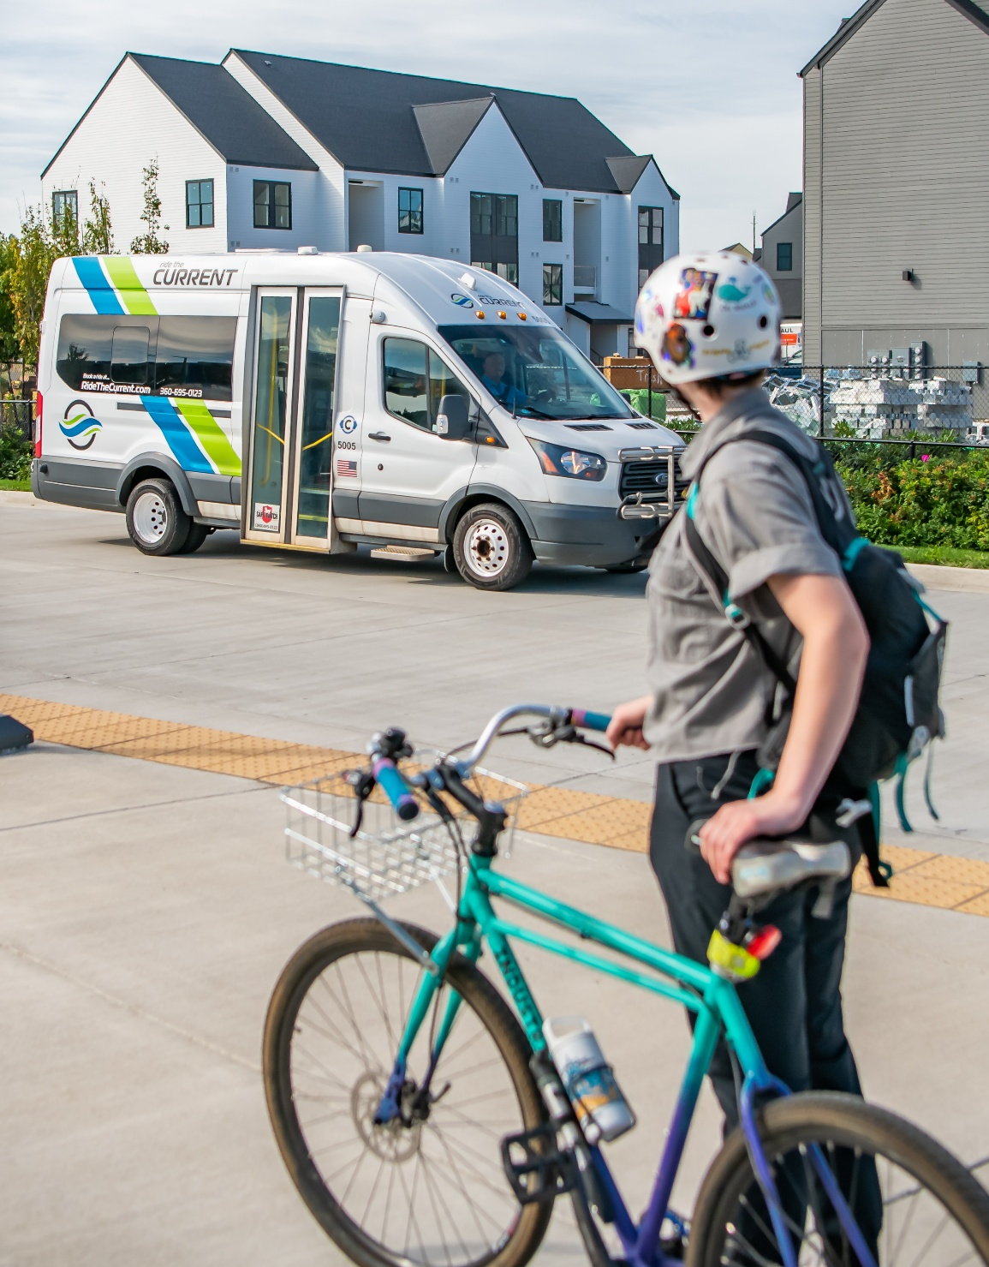
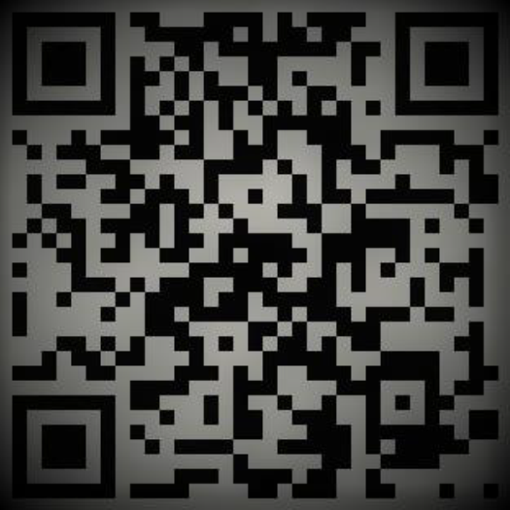

Commute Trip Reduction Survey
Take the Survey!
Our state-mandated Commute Trip Reduction transportation survey is happening from [INSERT SURVEY DATES].
The surveys asks how employees get to work on a typical week and is how we track our performance over time.
Your participation is critical to meeting the program requirements!
Taking the survey is easy!
Available online
Takes 5 minutes or less
Available in multiple languages
100 people can win a $10 gift card for completing the survey
The CTR law requires WSDOT to report on CTR program performance. The survey helps us understand and report reductions in air pollution and energy use and monitor the effectiveness of CTR programs implemented at your business.
Visit tdmboard.com for more information.

Slide 2

Commute Trip Reduction Survey
Take the Survey!
Our state-mandated Commute Trip Reduction transportation survey is happening from [INSERT SURVEY DATES].
The surveys asks how employees get to work on a typical week and is how we track our performance over time.
Your participation is critical to meeting the program requirements!
Taking the survey is easy!
Available online
Takes 5 minutes or less
Available in multiple languages
100 people can win a $10 gift card for completing the survey
The CTR law requires WSDOT to report on CTR program performance. The survey helps us understand and report reductions in air pollution and energy use and monitor the effectiveness of CTR programs implemented at your business.
Visit tdmboard.com for more information.

Slide 3
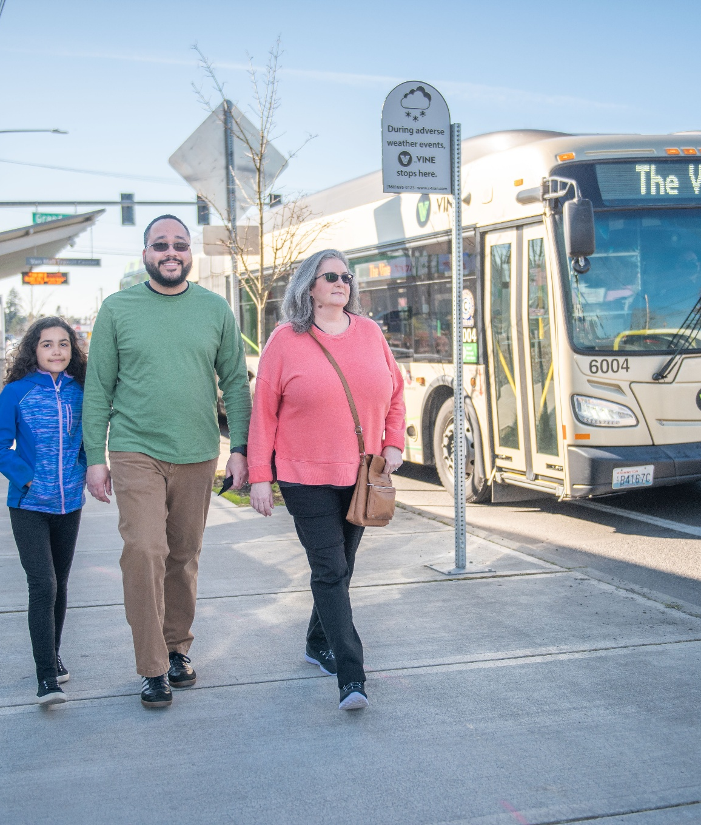
Commute Trip Reduction Survey
Take the Survey!
Our state-mandated Commute Trip Reduction transportation survey is happening from [INSERT SURVEY DATES].
The surveys asks how employees get to work on a typical week and is how we track our performance over time.
Your participation is critical to meeting the program requirements!
Taking the survey is easy!
Available online
Takes 5 minutes or less
Available in multiple languages
100 people can win a $10 gift card for completing the survey
The CTR law requires WSDOT to report on CTR program performance. The survey helps us understand and report reductions in air pollution and energy use and monitor the effectiveness of CTR programs implemented at your business.
Visit tdmboard.com for more information.

Slide 4
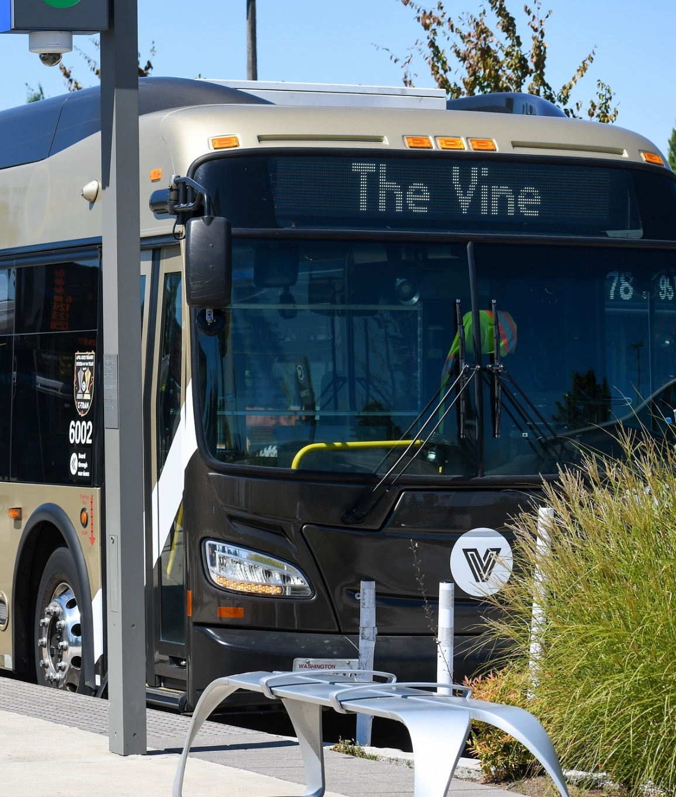
Commute Trip Reduction Survey
Take the Survey!
Our state-mandated Commute Trip Reduction transportation survey is happening from [INSERT SURVEY DATES].
The surveys asks how employees get to work on a typical week and is how we track our performance over time.
Your participation is critical to meeting the program requirements!
Taking the survey is easy!
Available online
Takes 5 minutes or less
Available in multiple languages
100 people can win a $10 gift card for completing the survey
The CTR law requires WSDOT to report on CTR program performance. The survey helps us understand and report reductions in air pollution and energy use and monitor the effectiveness of CTR programs implemented at your business.
Visit tdmboard.com for more information.

